Slide 1
P1 Presentation
Nick Cunningham
Dakota Golightly
Victor Mumford
Sai Donepudi

Slide 2
Team Intro Slide
Nick Cunningham - _
Dakota Golightly - _
Victor Mumford – Hopeful VR dev.
Sai Donepudi - _

Slide 3
Description of Omega Chess
Omega Chess is much like standard chess, but with these key differences:
The board is 9x9 (standard chess is 8x8), but also with four additional corner squares.
There are two new units: the wizard, and the champion.
The wizard can either move to diagonal squares, or move in a 3x1 L shape, as opposed to the Knight’s 2x1 L.
The champion can move 1-2 spaces in the cardinal directions, or exactly two spaces in the diagonal directions.
There are two of these new units per side. The Champions are put in the extra column spaces next to the Rooks, and the Wizards are put in the extra corner spaces.
Pawns can move 1-3 spaces on their first turn.

Slide 4
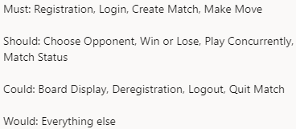
Slide for User Stories
The stories we created fell into 5 Epics: Registration, Matchmaking, Player History, Game Shell, and Gameplay.
Stories were prioritized according to Must/Should/Could/Would.

Slide 5
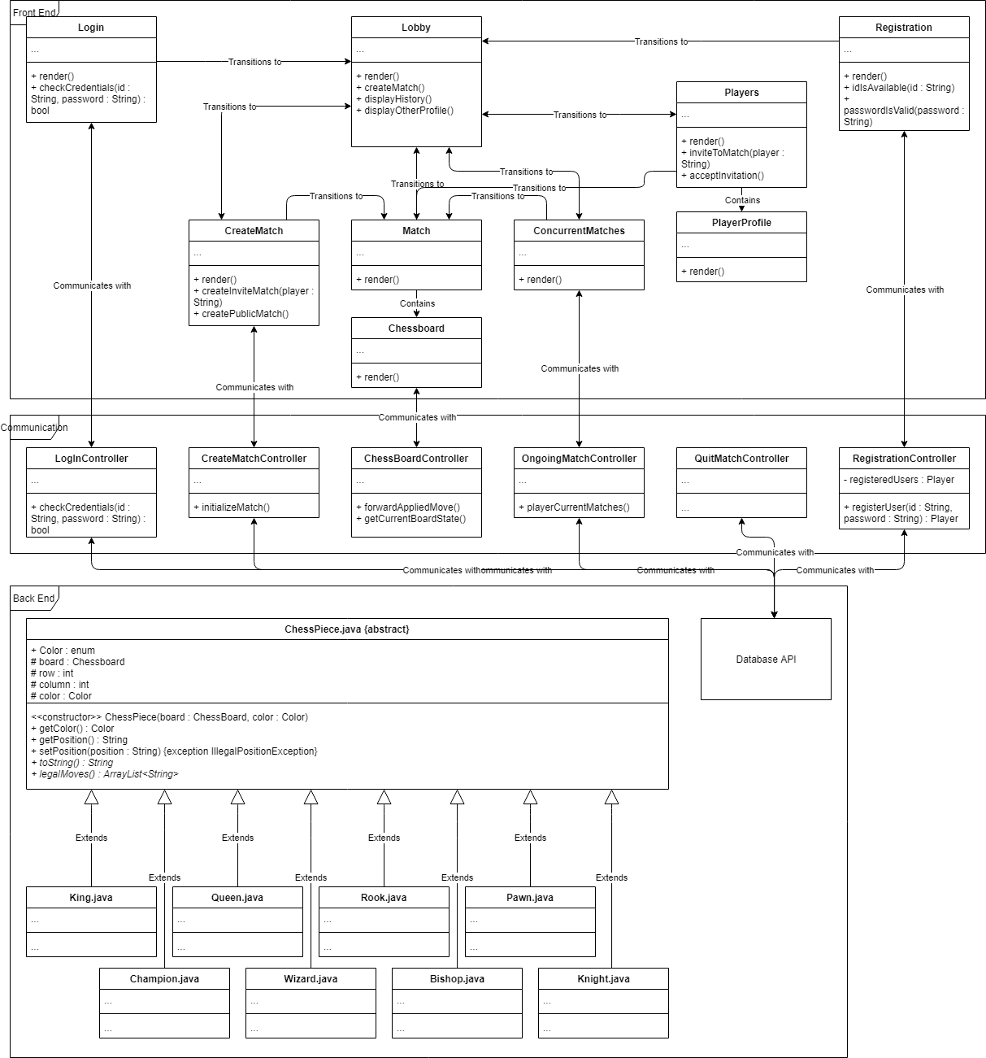
Class Diagrams

Slide 6
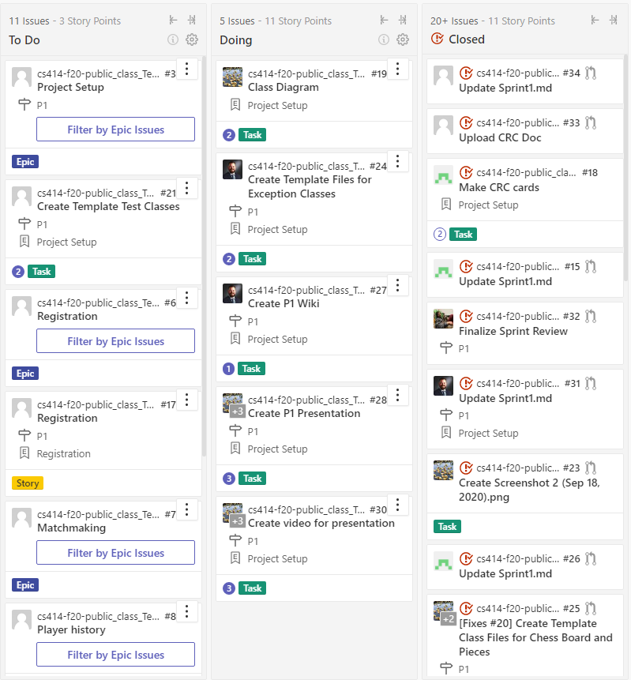
Kanban board

Slide 7
Scrum Ceremonies
Scrum ceremonies let us coordinate between ourselves and where we needed to be in the project. Post-scrum time was a reliable time for us all to work and talk together at the same time, instead of asynchronously.
Material results included the Sprint documentation in Sprint1.md.
The most valuable results were process results, which included concrete listing of tasks in ZenHub for us to complete and orientation/planning to complete those tasks.

